Slide 1

BORN FOR TECHNOLOGY
PROJECT TITLE
Understanding the Challenge

Slide 2

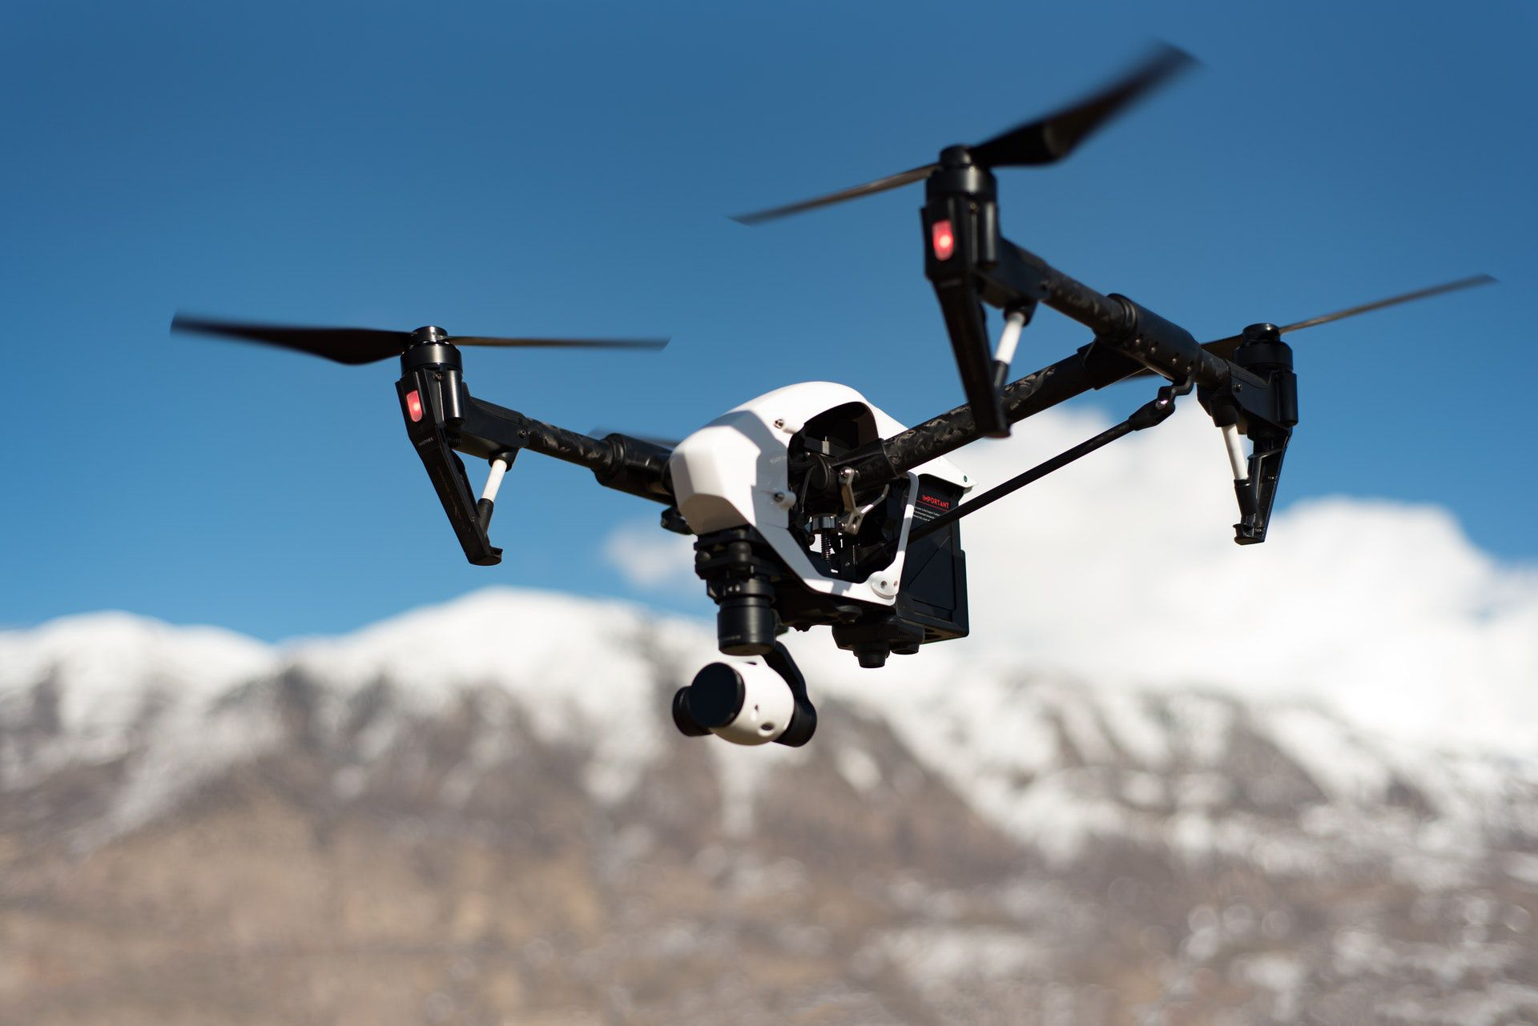
PROJECT: 3
PROJECT ID:proj _225027 _Team_1
TEAM MEMBERS:
1.Priyadharshini.N
2.Dharshinipriya.N
3.Shinyangel
4.Bhasira
5.Pooja
e

Slide 3
Project Description:
Understanding the Challenge:
Challenge: Our project aims to create an intelligent conversational chatbot using Python to deliver outstanding customer service. This involves the chatbot understanding natural language queries, utilizing AI techniques for precise responses, and continually enhancing its capabilities based on real user interactions.

Slide 4
Goals:
1. Ensure a seamless, human-like customer experience.
2. Increase query resolution rates.
3. Reduce wait times.
4. Boost customer satisfaction.
5. Proactively assist users and resolve their issues instantly without human involvement.
Defining the Problem:
The Problem: With the increasing usage of websites and mobile apps, there's been a significant rise in customer queries and support requests. Customers expect rapid online resolutions, yet providing 24/7 human support is costly and inefficient.

Slide 5
Solution Needed: We aim to develop intelligent chatbots that can emulate human agents, providing personalized, instant, and accurate responses.
Main Challenge: Our primary challenge is to build a Python chatbot that comprehends natural language, interprets user intents accurately, and delivers effective solutions.
Using Advanced AI Techniques
AI Techniques: We will leverage natural language processing (NLP), machine learning, and deep learning to:
1. Analyze user inputs.
2. Extract context.
3. Interpret intents and entities.
4. Provide appropriate responses.

Slide 6
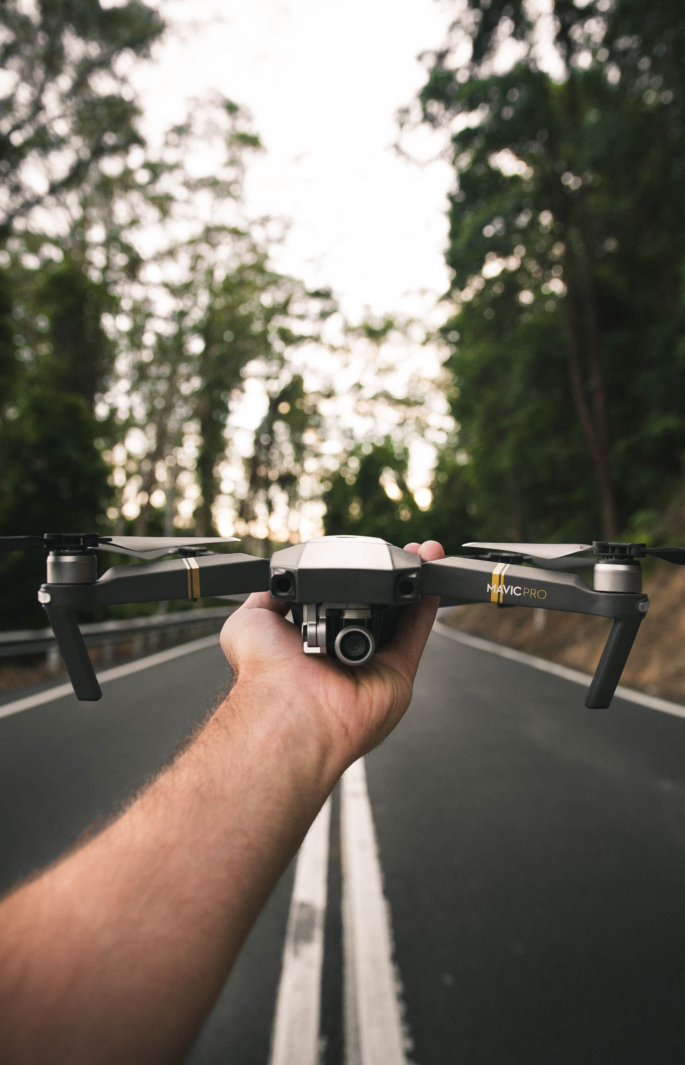
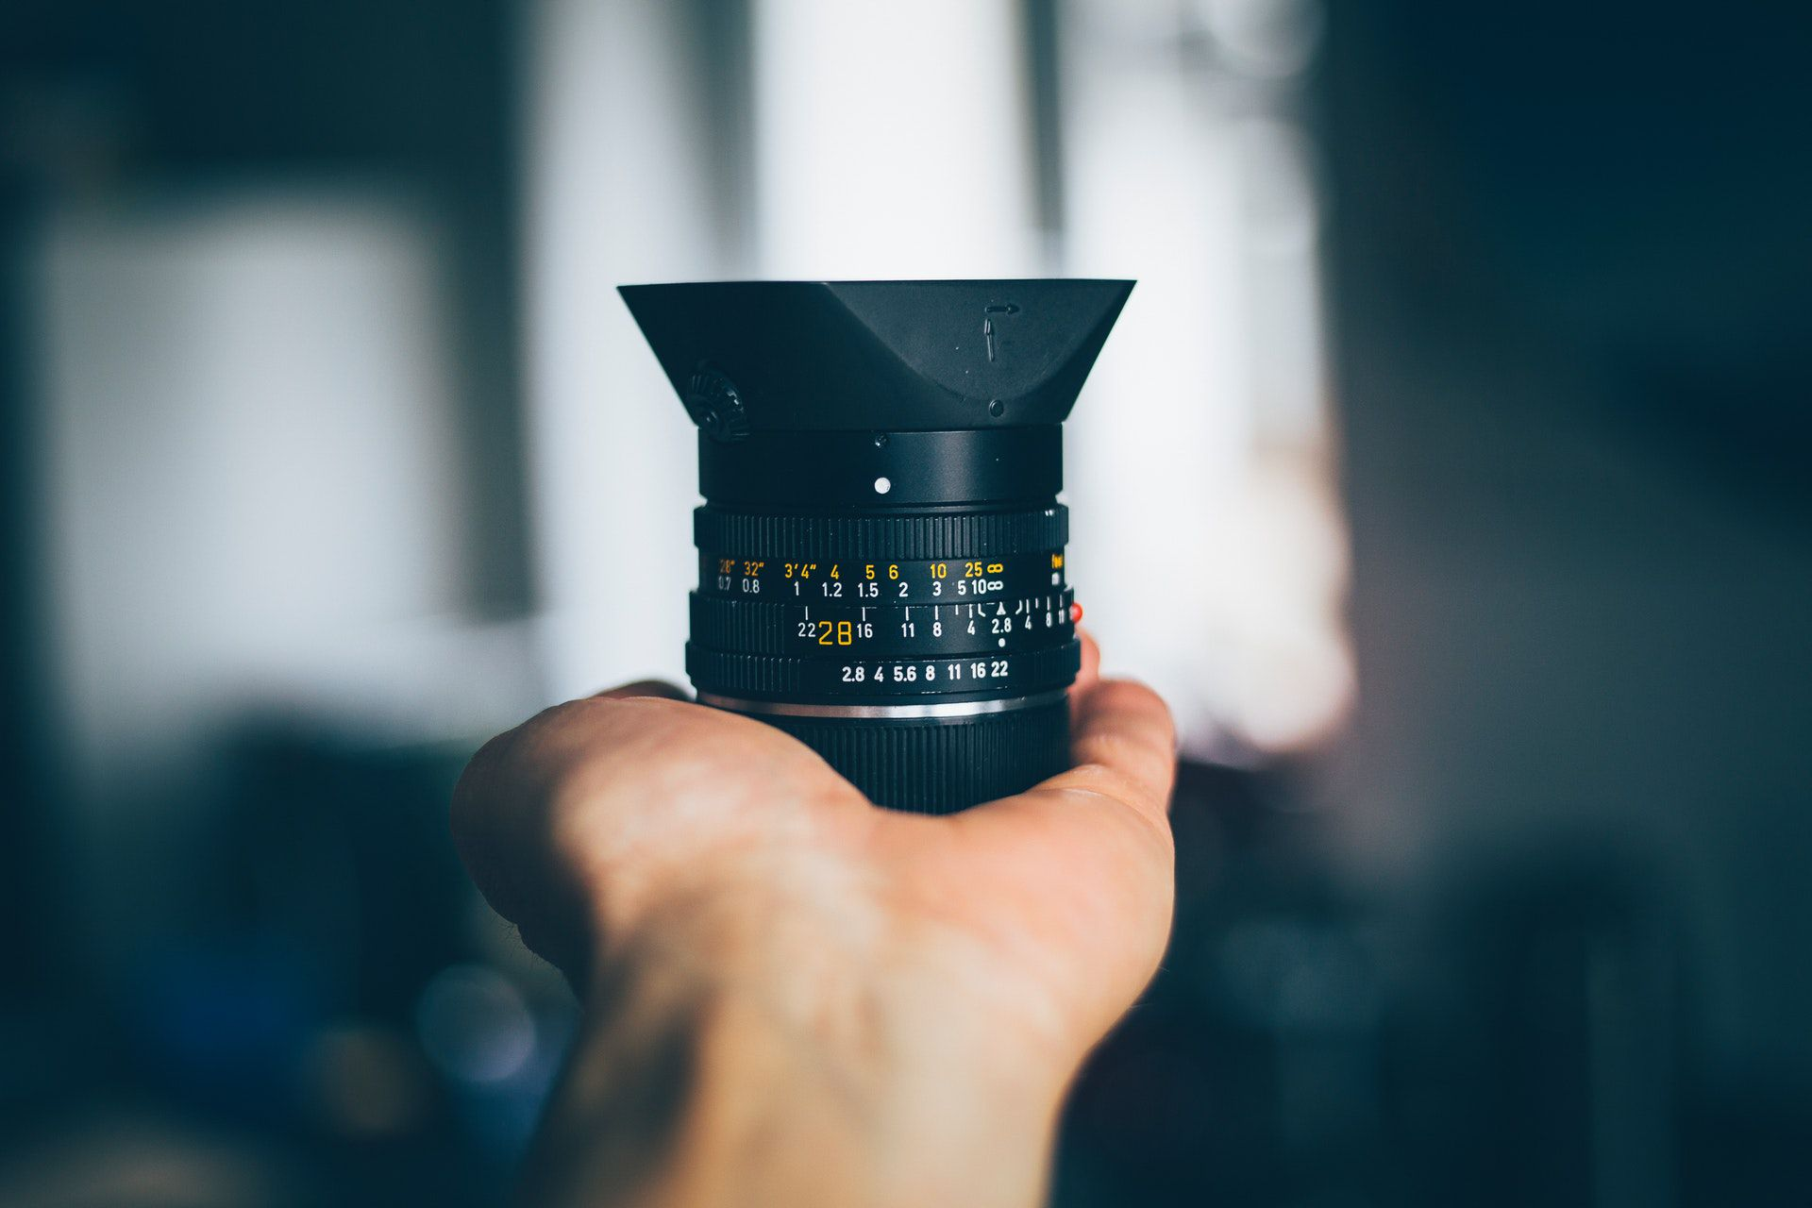

Broad Functionality
Functionality Scope:
1. Answering FAQs across various domains.
2. Providing instructions and recommendations.
3. Directing users to resources.
4. Addressing issues like registration, payments, refunds.
5. Integrating with internal systems for user-specific data.
Design Thinking
User Interface Design
Placement: Determine where the chatbot will be used, whether on websites, mobile apps, or both.

Slide 7
User-Friendly Interface:
1. Intuitive design.
2. Accessibility through text and voice input.
3. Personalization with user details.
Enhancing Natural Language Processing
NLP Techniques: Implement advanced NLP methods, including sentiment analysis, named entity recognition, intent classification, dialogue management, and pretrained language models like BERT.
d title
Add title

Slide 8
User-Friendly Interface:
1. Intuitive design.
2. Accessibility through text and voice input.
3. Personalization with user details.
Enhancing Natural Language Processing
NLP Techniques: Implement advanced NLP methods, including sentiment analysis, named entity recognition, intent classification, dialogue management, and pretrained language models like BERT.

Slide 9
Crafting Effective Responses
Response Strategies:
1. Develop an extensive FAQ knowledge base.
2. Create dynamic responses with templates and user/context variables.
3. Retrieve data from integrated systems.
4. Establish a feedback loop for continuous improvement.
Seamless Integration
Integration Options: Seamlessly integrate the chatbot into applications or websites using APIs, webhooks, and data protocols.
Add a subtitle
There are many variations of passages available the majority There are many variations of passages available the majority.

Slide 10
Activity Logging: Log user interactions for tracking and analysis in CRM systems. Testing and Improvement Continuous Enhancement: 1. Beta testing with real users. 2. Performance analysis through conversation logs. 3. Monitoring KPIs like resolution rates and user satisfaction. 4. Tuning NLP models based on feedback. 5. Leveraging reinforcement learning for improvement. 6. Evaluating capability to handle complex queries and measuring progress. Final Objective End Goal: Our ultimate objective is to develop a smart Python chatbot that automates customer support, providing exceptional, human-like service without the need for live agents.

Slide 11
T
H
A
N
K
S

